Slide 1
Analiza YELP podatkovne baze s tehnologijo Microsoft Analysis Services
Primož Hrovat
Jakob Gaberc Artenjak

Slide 2
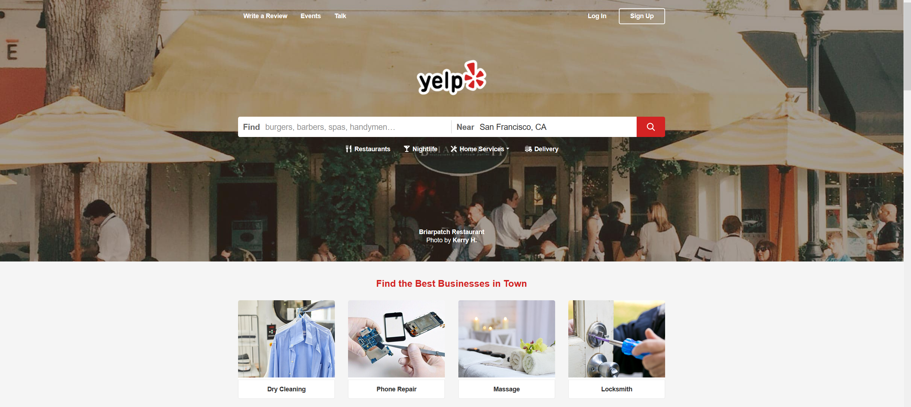
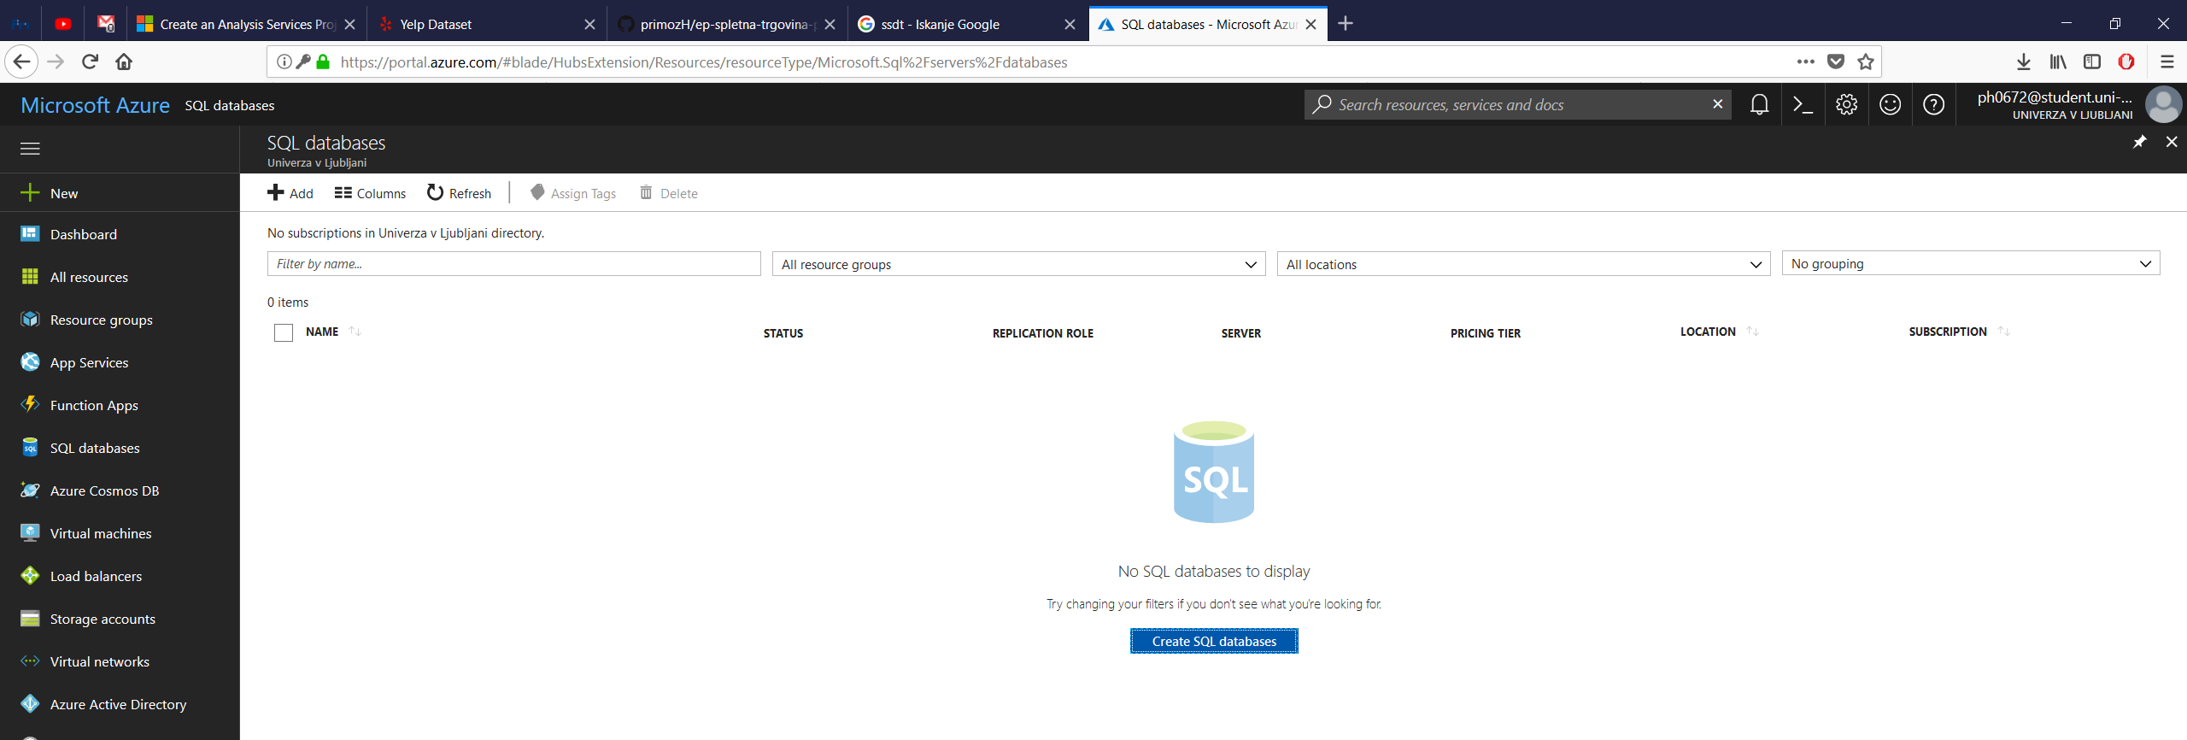
Uvod
Prvotni cilj naloge je bila uporaba Microsoft Azure
Omejitev velikosti SQL baze 32MB
Skupna velikost dejanske baze okrog 7GB
Uporaba privatnega SQL Serverja, vendar…
YELP
https://www.yelp.com/
Od leta 2004
Ocenjevanje poslovnih subjektov
“community driven”

Slide 3
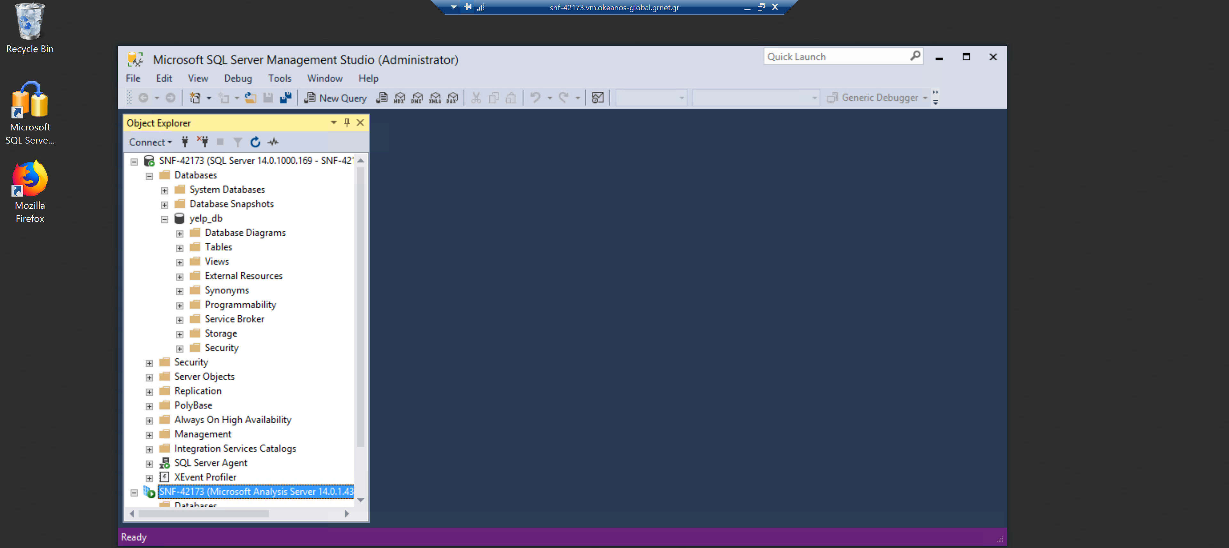
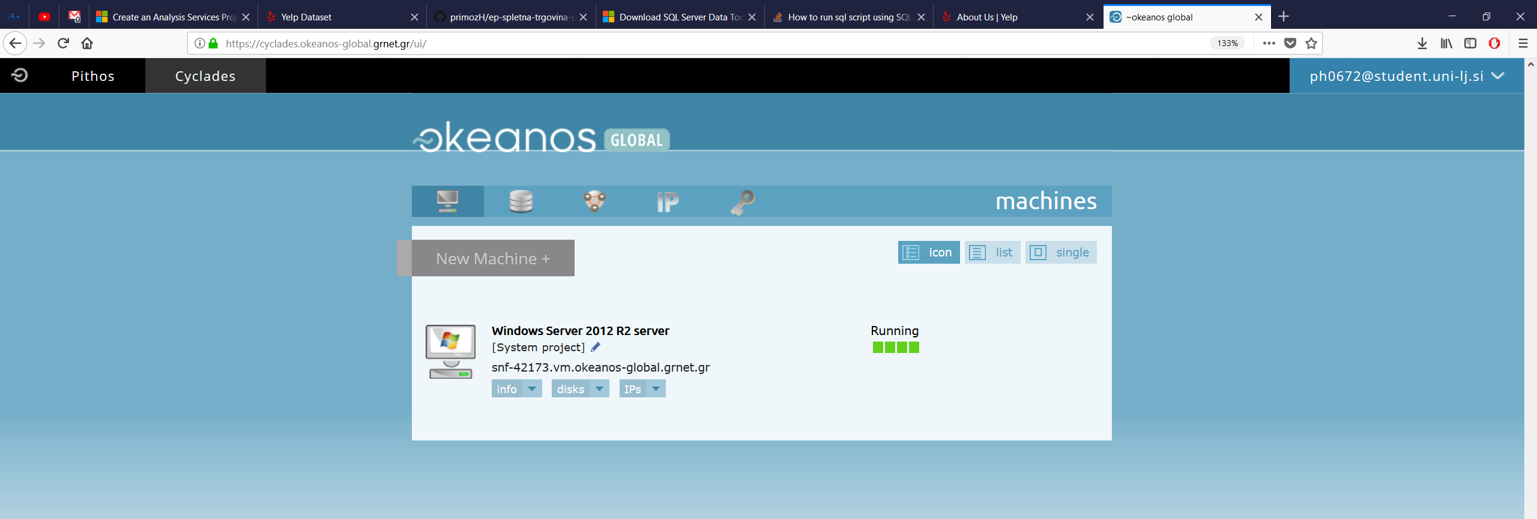
Priprava podatkovne baze
Grški Okeanos (omrežje GÉANT)
Microsot Windows Server 2012
Namestitev Microsoft SQL Server 2017 z razširitvijo Analysis Services
Nepodprtost MS SQL
Uvoz v MYSQL
Uporaba migracijskega orodja za prenos podatkov iz MYSQL v MS SQL
Nizek odstotek uspešnih prenosov!
Priprava OLAP kocke
Problem pri ustvarjanju – dostop omogočen samo preko Windows AD!
Notes:
10 Things You Should Know About Yelp
Yelp was founded in 2004 to help people find great local businesses like dentists, hair stylists and mechanics.
Yelp had a monthly average of 30 million unique visitors who visited Yelp via the Yelp app and 74 million unique visitors who visited Yelp via mobile web in Q3 2017.*
Yelpers have written more than 142 million reviews by the end of Q3 2017
In addition to reviews, you can use Yelp to find events, lists and to talk with other Yelpers.
Every business owner (or manager) can setup a free account to post photos and message their customers.
Yelp makes money by selling ads to local businesses - you’ll see these clearly labeled "Yelp Ads" around the site.
Paying advertisers can never change or re-order their reviews.
Yelp uses automated software to recommend the most helpful and reliable reviews for the Yelp community among the millions we get. The software looks at dozens of different signals, including various measures of quality, reliability, and activity on Yelp. The process has nothing to do with whether a business advertises on Yelp or not. Learn more here.
You can access Yelp via iPhone, Android, and more - see the full list of mobile apps here.
The Local Yelp brings locals updates on the latest and greatest business openings & other happenings.

Slide 4
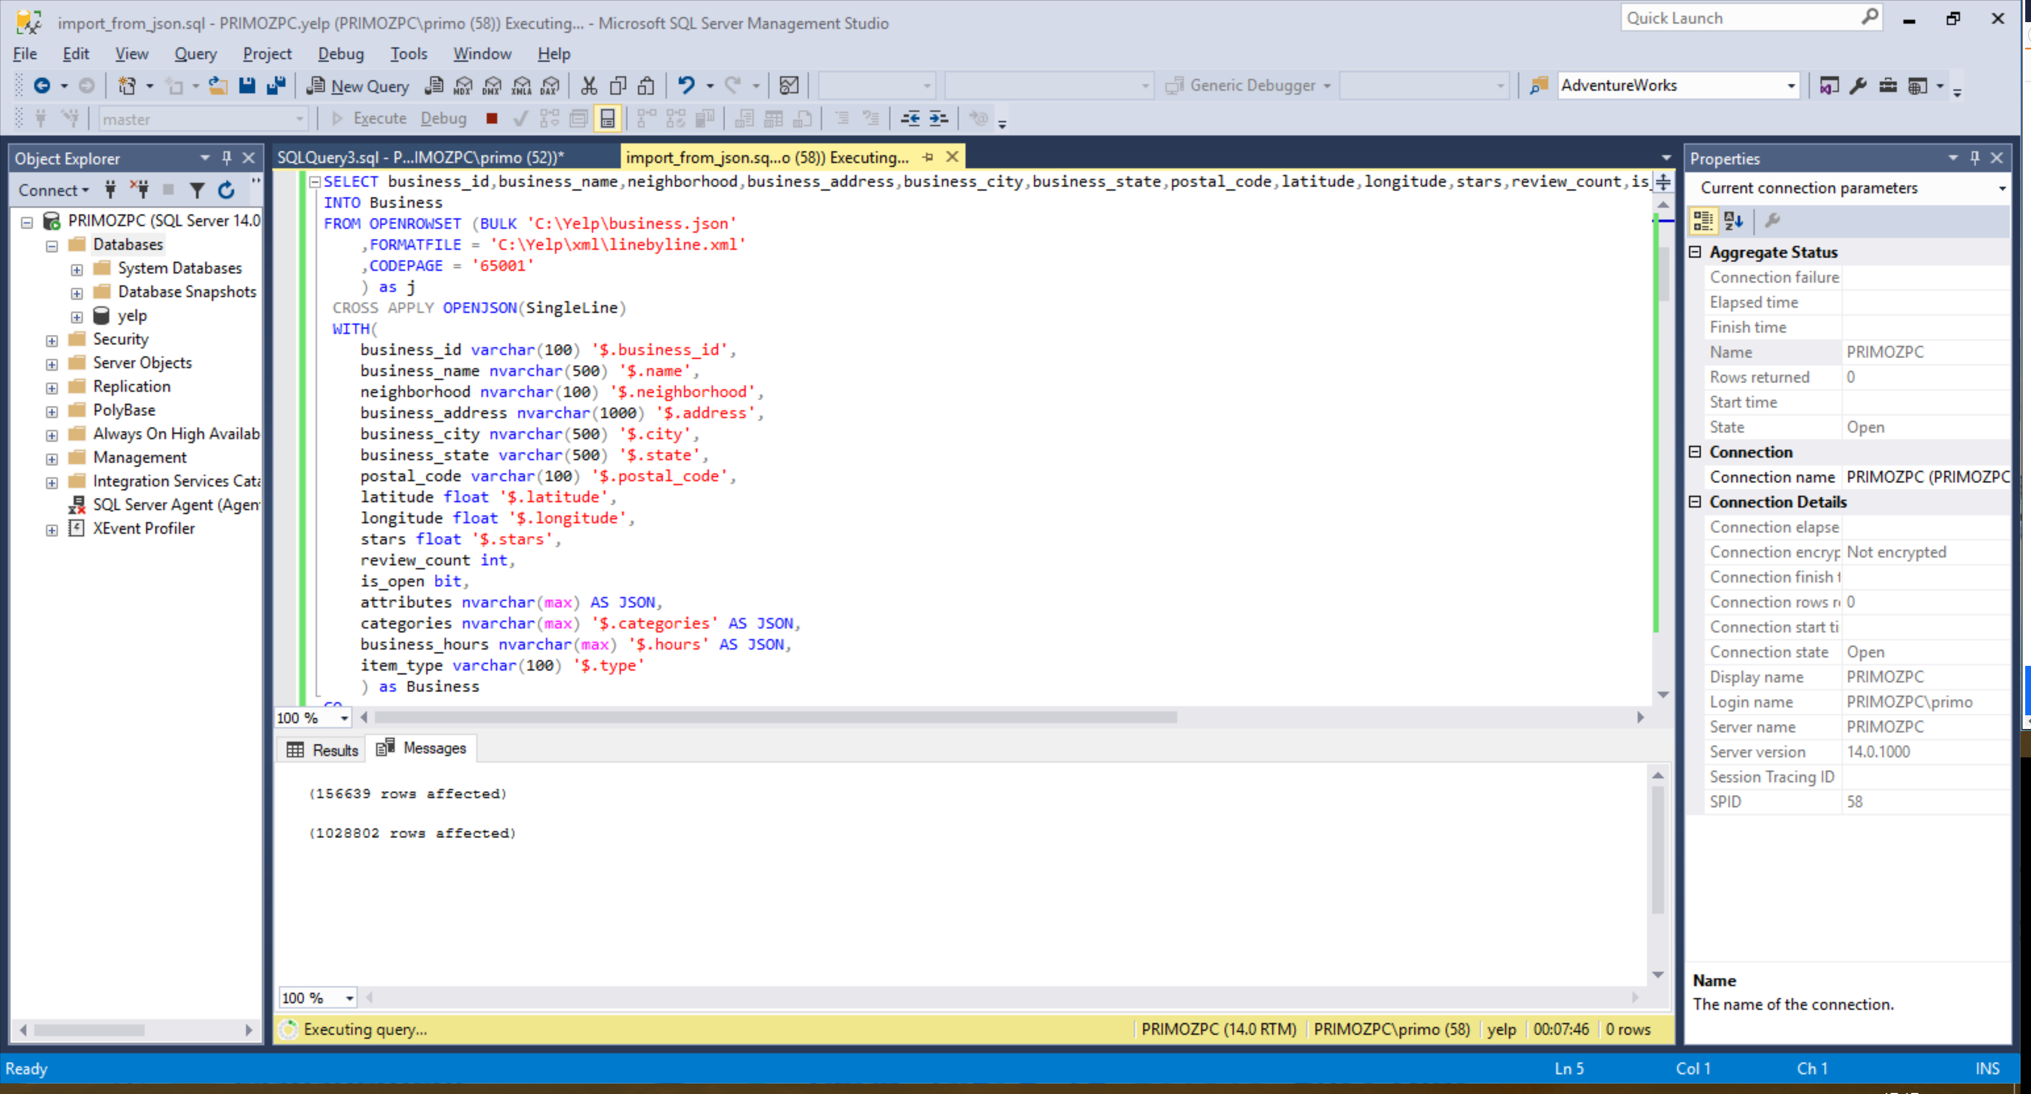
Priprava podatkovne baze - REŠITEV
Lokalna namestitev MS SQL in Analysis Services
Uporaba JSON oblike zapisa podatkov in “ročna” obdelava

Slide 5
SQL Server Data Tools (SSDT)
Gradnja OLAP kocke z grafičnimi gradniki
Definiranje dimenzij, mer…

Slide 6
Ocene poslovnih subjektov

Slide 7
Aktivnost uporabnikov

Slide 8
Zaključek
Nove izkušnje
Uporaba MS SQL
Analysis Services
Problemi s kompatibilnostjo različnih SQL baz
Izvedba poizvedb nad večjo količino podatkov

